Slide 1

Cosmic voyagers
Will It Rain on My Parade?
🎯 The Challenge
Event planners face a constant dilemma: weather forecasts are either too broad or lack the precision needed for critical outdoor decisions. Rain can devastate festivals, parades, and community gatherings, resulting in significant financial losses and disappointed attendees.
The solution requires a reliable, hyperlocal system that delivers credible NASA satellite data through simple, actionable visualizations.
Team members:
Giripogu Neha
Kanchugantala Harshitha
Jeeviguntla Sathvika
Mangali Sai kushal
Gollapalle venkata sai
Kalugotla naga divya

Slide 2
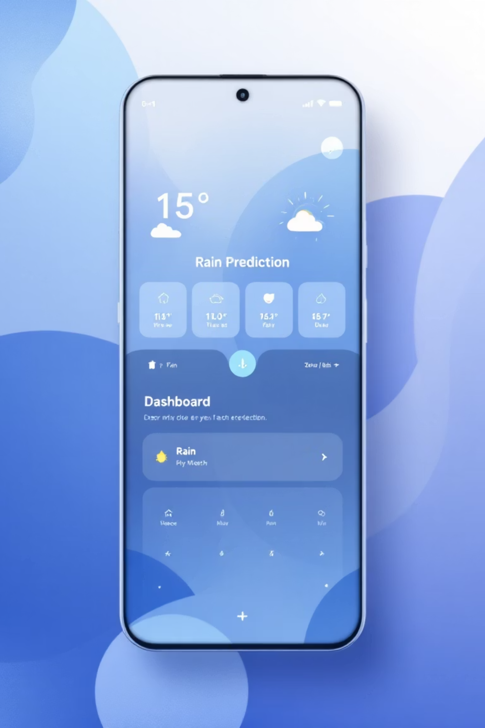
💡 AI-Driven Rain Prediction Solution
NASA-Powered Intelligence
Location-Specific Forecasts
Leverages satellite precipitation data for unmatched accuracy
Pinpoint predictions for any location worldwide
Simple Decision Making
Clear visualizations that eliminate guesswork

Slide 3
🧠 How It Works
01
02
Location Input
NASA Data Retrieval
User selects city or enables GPS for precise positioning
System fetches real-time precipitation data from NASA POWER API
03
04
AI Analysis
Visual Output
Advanced algorithms analyze patterns to predict rainfall probability
Displays clear results: rain forecast, trend charts, and interactive maps

Slide 4

🔭 NASA Data Foundation
NASA POWER Dataset
Prediction Of Worldwide Energy Resources provides comprehensive daily surface meteorological data including:
PRECTOT: Total daily precipitation (mm/day)
T2M: Temperature at 2 meters
RH2M: Relative humidity levels
This robust dataset ensures our predictions are grounded in proven satellite observations covering the entire globe.

Slide 5





⚙️ Technical Architecture
User Interface Layer
Web app captures location input
Geolocation Processing
Converts city names to precise coordinates
NASA Data Integration
Real-time API calls to POWER database
AI Prediction Engine
Machine learning models analyze precipitation patterns
Visualization Output
Interactive charts and clear rain/no-rain decisions

Slide 6

📈 Expected Outcomes
🎯 Precision Forecasting
NASA satellite data ensures accuracy you can trust for critical decisions
📊 Clear Insights
Visual trends make complex weather data instantly understandable
🌍 Global Coverage
Works anywhere worldwide with just a city name or coordinates
💪 Confident Planning
Empowers event organizers to make weather-dependent decisions with certainty

Slide 7




🌍 Real-World Impact
🎉 Event Planners
🚜 Agricultural Planning
🚗 Travel & Tourism
🏫 Educational Events
Schedule festivals and parades confidently, avoiding last-minute weather surprises that cost thousands in setup and logistics.
Travelers and tourists can plan outdoor activities effectively, maximizing their experience and safety.
Schools and organizations can safely organize outdoor activities, ensuring student safety and event success.
Farmers can optimize irrigation schedules and protect crops by knowing exactly when rain is expected.

Slide 8
🧩 Future Enhancement Roadmap
Phase 1: ML Forecasting
Phase 3: Mobile Alerts
Deploy advanced machine learning models trained on historical NASA data for multi-day predictions with enhanced accuracy.
Launch mobile app with push notifications: "Rain expected in next 6 hours" for proactive event management.
1
2
3
4
Phase 2: Interactive Mapping
Phase 4: Enhanced Data
Integrate Google Maps allowing users to click anywhere globally for instant hyperlocal rain predictions.
Incorporate additional NASA datasets including GPM and MODIS for unprecedented forecast precision.

Slide 9
🎯 Project Excellence Summary
NASA Integration
1
Authentic use of NASA Earth Observation data through POWER API, demonstrating genuine space technology application
Technical Innovation
2
Novel combination of geolocation services, satellite data, and predictive AI creates unique weather intelligence
Human-Centered Impact
3
Addresses real-world pain points for event planners, farmers, and communities making weather-dependent decisions
Universal Accessibility
4
Simple web interface using open NASA APIs makes advanced weather prediction available to everyone globally
Scalable Architecture
5
Foundation designed for seamless expansion into mobile apps, enterprise solutions, and advanced AI capabilities

Slide 10

Empowering Confident Decisions
"Will It Rain On My Parade?" transforms NASA's satellite technology into a powerful decision-making tool, empowering everyone from festival organizers to farmers to make weather-dependent choices with unprecedented confidence and clarity.
When planning matters most, trust the data that comes from space.

